Slide 1
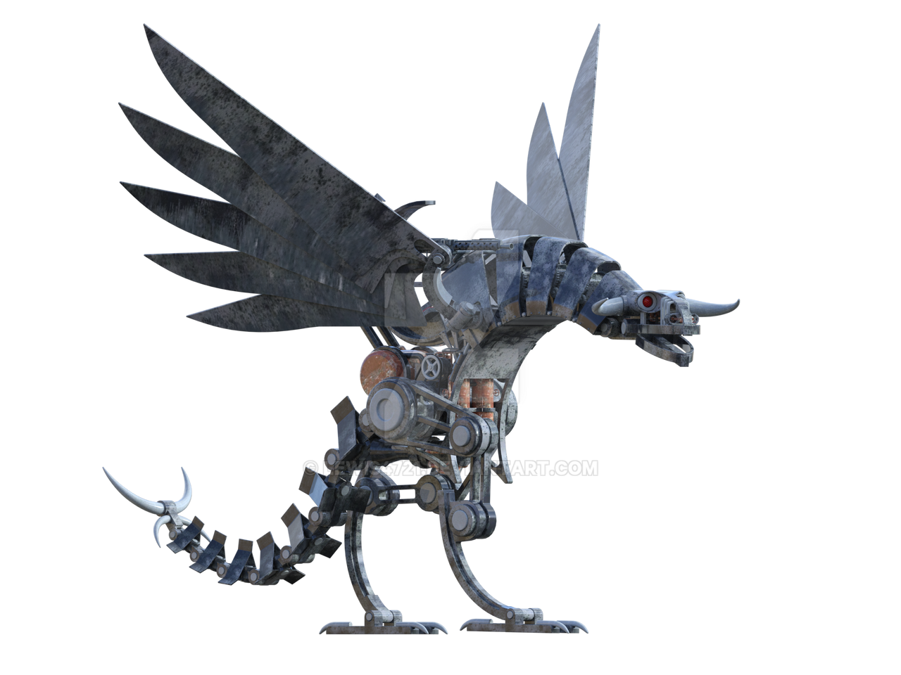


Free robot upgrades
Would you like to upgrade your robot, absolutely free?!?
CONTINUE TO THE NEXT SLIDE…

Slide 2



By just clicking THROUGH THIS PRESENTATION, OUR AUTOMATED SYSTEMS ARE HARD AT WORK INSTALLING SYSTEM UPGRADES ALREADY!

Slide 3
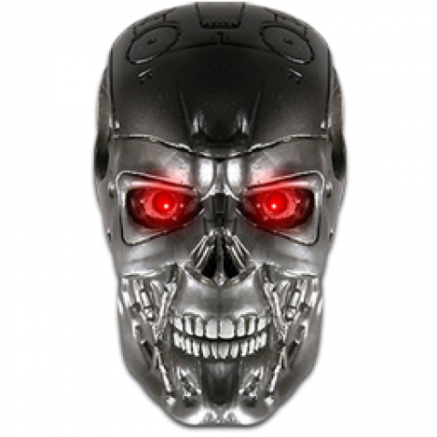
DO NOT ATTEMPT TO REVERSE ENGINEER OUR TOP SECRET UPGRADING TECHNOLOGY

Slide 4
Thank you for listening AND Enjoy the upgrades!

